Slide 1
Capstone Engagement
Assessment, Analysis, and Hardening of a Vulnerable System

Slide 2
Table of Contents
This document contains the following sections:
01
Network Topology
02
Red Team: Security Assessment
03
Blue Team: Log Analysis and Attack Characterization
Hardening: Proposed Alarms and Mitigation Strategies
04

Slide 3
Network Topology
‹#›

Slide 4
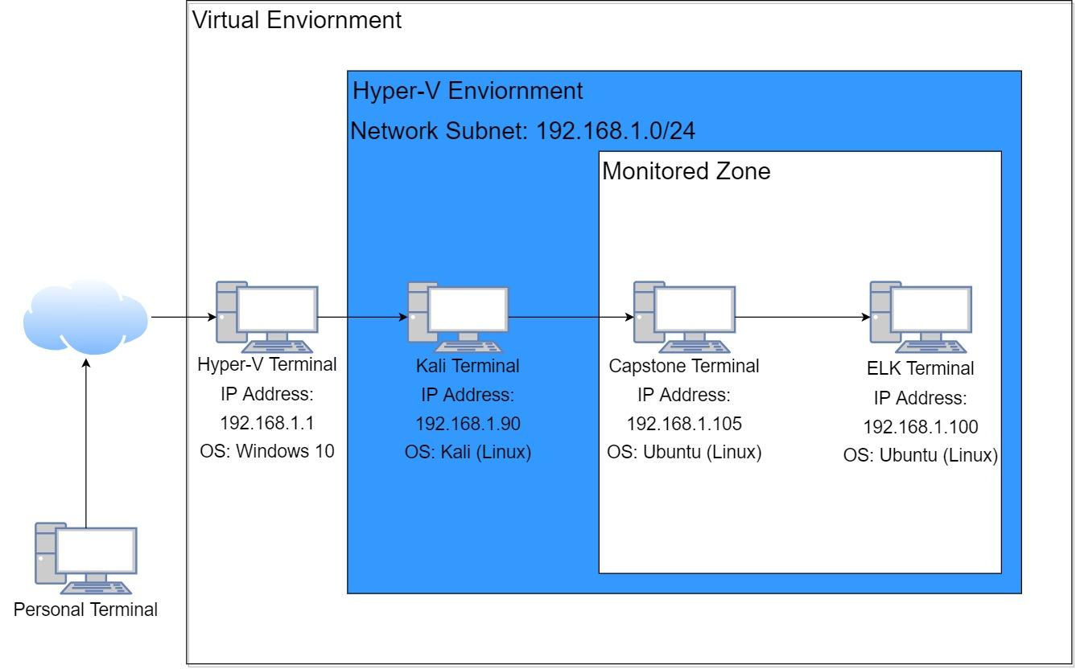
Network Topology
Network
Address Range: 192.168.1.0/24
Netmask: 255.255.255.0
Gateway: 192.168.1.1
Machines
IPv4: 192.168.1.1
OS: Windows 10
Hostname: Hyper-V
IPv4: 192.168.1.90
OS: Kali (Linux)
Hostname: Kali
IPv4: 192.168.100
OS: Ubuntu (Linux)
Hostname: ELK
IPv4: 192.168.1.105
OS: Ubuntu (Linux)
Hostname: Capstone

Slide 5

Red Team
Security Assessment
‹#›

Slide 6
Recon: Describing the Target
Nmap identified the following hosts on the network:
Hostname | IP Address | Role on Network
Hyper-V | 192.168.1.1 | Hypervisor
Kali | 192.168.1.90 | Attack Machine
ELK | 192.168.1.100 | Monitoring Machine
Capstone | 192.168.1.105 | Victim Machine

Slide 7
Vulnerability Assessment
The assessment uncovered the following critical vulnerabilities in the target:
Vulnerability | Description | Impact
Port scanning | Method to determine what ports are open. | Attackers can discover vulnerabilities associated with each visible open port with a port scan.
Broken Authentication | Broken Authentication attacks are used to exploit user accounts. | Attackers that are able to obtain valid credentials are able to have access to password protected directories and files.
Sensitive Data exposure | Sensitive Data is any information that is meant to be protected from unauthorized access. | If Attackers are able to obtain exposed credentials they will be able to elevate their access to other resources in the domain/server.
Local File Inclusion | A Local File Inclusion are attacks that happen when an application includes a file as user input without properly validating it. | Attackers are able to trick the web application into running malicious files on the web server.

Slide 8
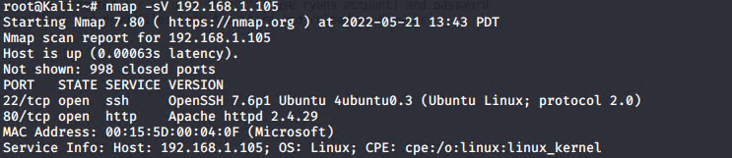
Exploitation: Port Scanning
01
02
Tools & Processes
Due to open ports being visible during a Nmap scan, I was able to determine the victims IP address as well as the port and service version being used to host a web server.
Achievements
I was able to find the IP address of the server and determine that the server was using port 80 to host the website.
03

Slide 9
Exploitation: Broken Authentication
01
02
Tools & Processes
The tools I used to exploit the web server’s broken authentication vulnerability was by using hydra to perform a brute force attack. The web servers lists the name of the person in charge of system administration. I used their name as the username and used a wordlist to brute force the password with hydra.
Achievements
The exploited granted access to a restricted secret folder that contained a file describing the process to gain access to the webdav directory.
03

Slide 10
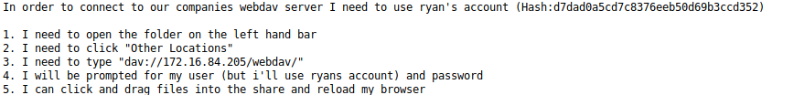
Exploitation: Sensitive Data Exposure
01
02
Tools & Processes
After gaining access to the file in the restricted secret folder, I found a hash value.
I used john the ripper to crack the password.
Achievements
The exploited granted access to the webdav folder.
03

Slide 11
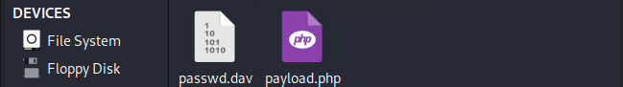
Exploitation: Local File Inclusion
01
02
Tools & Processes
After gaining access to the webdav server I was able to craft a PHP reverse shell payload using msfvenom and uploaded the payload to the server. I also setup a listener using the metasploit framework in order to catch the reverse shell after being executed.
Achievements
The exploit granted access to the web server operating system.
03

Slide 12

Blue Team
Log Analysis and Attack Characterization
‹#›

Slide 13

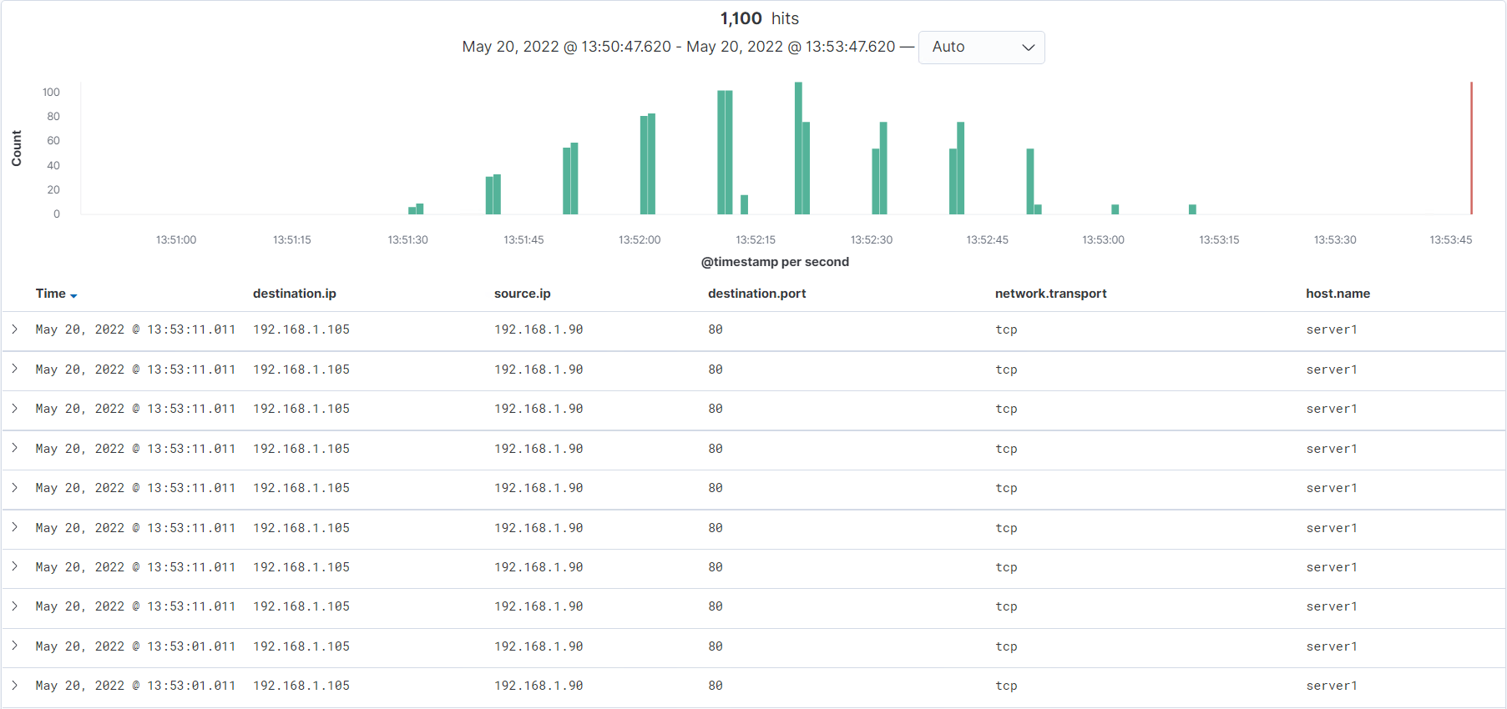
Analysis: Identifying the Port Scan
Answer the following questions in bullet points under the screenshot if space allows. Otherwise, add the answers to speaker notes.
What time did the port scan occur?
How many packets were sent, and from which IP?
What indicates that this was a port scan?
Notes:
What time did the port scan occur?
The port scan occurred at 1:53 pm.
How many packets were sent, and from which IP?
1,100 packets were sent.
What indicates that this was a port scan?
The destination ports were all different.

Slide 14
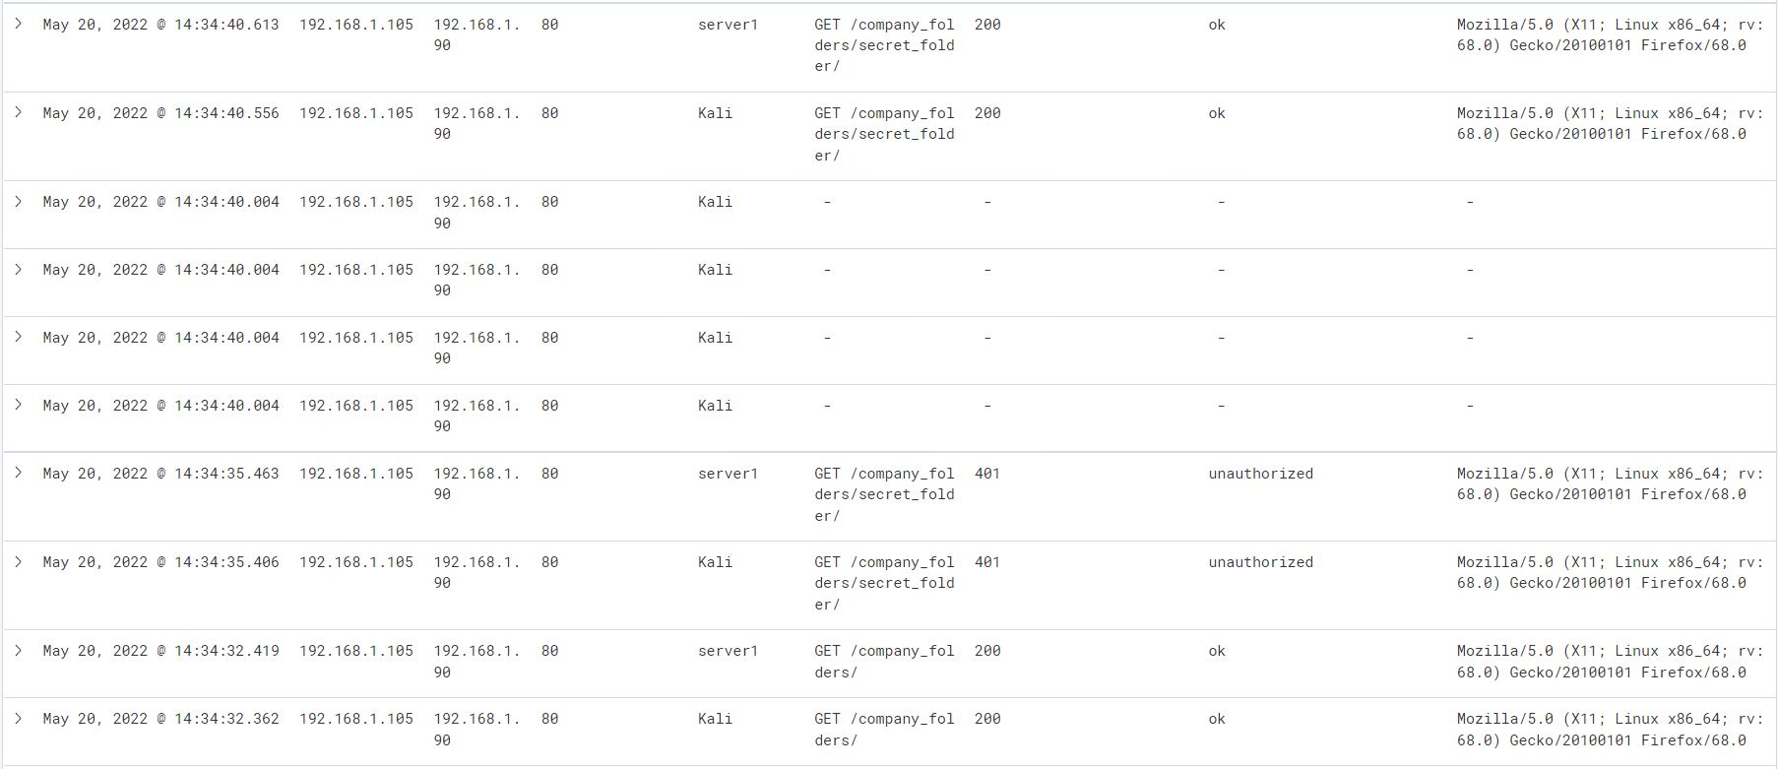
Analysis: Finding the Request for the Hidden Directory
Answer the following questions in bullet points under the screenshot if space allows. Otherwise, add the answers to speaker notes.
What time did the request occur? How many requests were made?
Which files were requested? What did they contain?
Notes:
What time did the request occur? How many requests were made?
The request occurred at 2:34 pm.
1 request was made.
Which files were requested? What did they contain?
The file requested was “secret_folder”.
It contains the “connect_to_corp_server” file

Slide 15
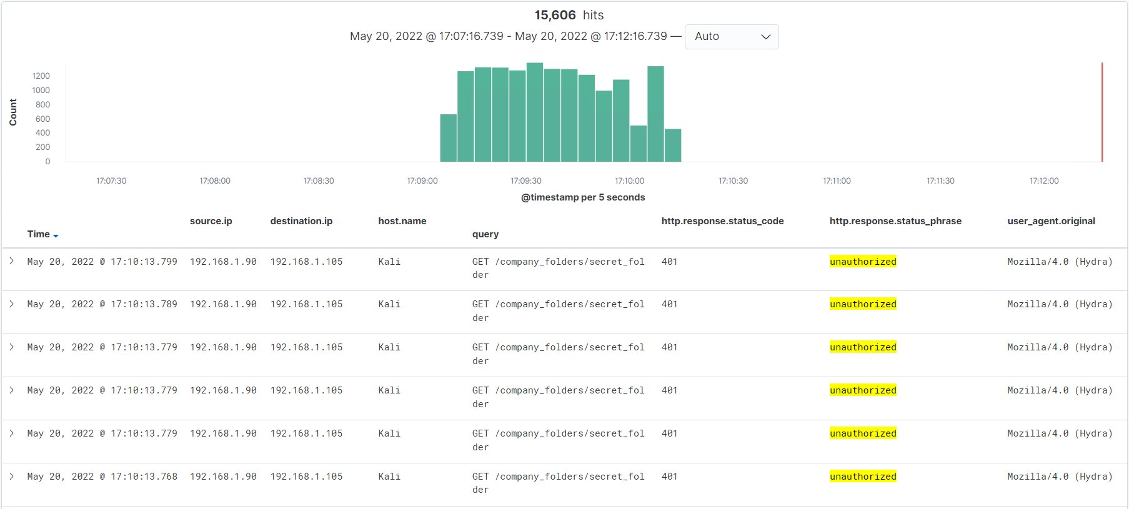
Analysis: Uncovering the Brute Force Attack
Answer the following questions in bullet points under the screenshot if space allows. Otherwise, add the answers to speaker notes.
How many requests were made in the attack?
How many requests had been made before the attacker discovered the password?
Notes:
How many requests were made in the attack?
There were 15,606 requests made during the brute force attack.
How many requests had been made before the attacker discovered the password?
Very few

Slide 16
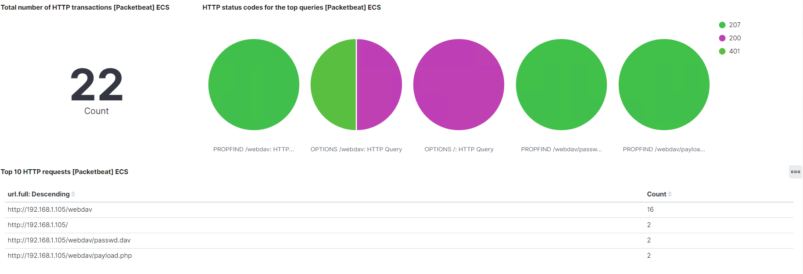
Analysis: Finding the WebDAV Connection
Answer the following questions in bullet points under the screenshot if space allows. Otherwise, add the answers to speaker notes.
How many requests were made to this directory?
Which files were requested?
Notes:
How many requests were made to this directory?
22 requests were made
Which files were requested?
Password.dav and payload.php

Slide 17
Blue Team
Proposed Alarms and Mitigation Strategies
‹#›

Slide 18
Mitigation: Blocking the Port Scan
What kind of alarm can be set to detect future port scans?
We can set-up an email alert.
What threshold would you set to activate this alarm?
The threshold for the alert should be for 10 or more incoming packets are requesting information about different ports from a single source in under a minute.
What configurations can be set on the host to mitigate port scans?
Configure the firewall to enable packet filtering to mitigate port scanning. Deny all ICMP requests from external hosts.
Setup a SIEM platform for monitoring port scan activity in real-time and setup response measures such as alerts for rapid response if needed..

Slide 19
Mitigation: Finding the Request for the Hidden Directory
What kind of alarm can be set to detect future unauthorized access?
Setup an email alert.
What threshold would you set to activate this alarm?
The threshold of the alert should be set to 3 failed attempts from a single internal IP address. External IP address failed attempts should trigger on each attempt.
What configuration can be set on the host to block unwanted access?
Implement error redirection, such as to deny any feedback to attackers by displaying a HTTP response code.
Adjust password policy requirements for users that have access to hidden directories.
Encrypt contents within hidden directories.

Slide 20
Mitigation: Preventing Brute Force Attacks
What kind of alarm can be set to detect future brute force attacks?
Setup an email alert.
What threshold would you set to activate this alarm?
The alert should trigger after 5 consecutive failed attempts.
What configuration can be set on the host to block brute force attacks?
Limit login attempts by locking the user account for a period of time after a 5 consecutive failed attempts.
Use a secure platform session manager to randomly generate session identifiers.
Setup MFA for all users so in the event they do acquire valid credentials they are unable to authenticate additional factors required by MFA.

Slide 21
Mitigation: Detecting the WebDAV Connection
What kind of alarm can be set to detect future access to this directory?
Setup an email alert for login attempts and login location.
What threshold would you set to activate this alarm?
The alert for failed attempts should trigger after 5 failed attempts. The alert for the login location should trigger every time an uncommon location is detected on login attempt.
What configuration can be set on the host to control access?
Limit login attempts by locking the user account for a period of time after a 5 consecutive failed attempts.
Only allow terminal that hold a recognized SSL certificate to connect to WebDAV.
Setup MFA for all users so in the event they do acquire valid credentials they are unable to authenticate additional factors required by MFA

Slide 22
Mitigation: Identifying Reverse Shell Uploads
What kind of alarm can be set to detect future file uploads?
Setup an email alert.
What threshold would you set to activate this alarm?
The alert should trigger every time anyone attempts to upload an executable file.
What configuration can be set on the host to block file uploads?
Limit allowed file types to avoid executable files from being uploaded.
Setup an anti-malware engine such as McAfee Gateway Anti-Malware engine to can all uploaded files for malware.
Store uploaded files outside of the websites public directory to prevent attackers from executing any uploaded files.

